Slide 1
Estimation
Notes:
1

Slide 2
Objectives
Estimating Concepts and Principles
Virtusa 3 Level Estimation Workflow
Estimate using Virtusa Level 1 Estimation Template
Outputs of Estimation Process
Identify and Quantify Risks
Estimation Tips – General
Sample Level 1 Estimation Template

Slide 3
Estimating Concepts and Principles

Slide 4
Fundamentals of Estimation
Estimation is an informed approximation of Cost and Time required to
execute a task or a project (a set of tasks)
Provides an idea of what it takes to build a desired output
Knowledge and Experience help make the estimates accurate
Without proper Estimation
Cost and time are wild guesses
End up spending (usually) far more cost and time than anticipated
Either go bankrupt or abandon the project midway through
Whatever is spent till then goes waste
Notes:
4

Slide 5
Fundamentals of Estimation - Contd.
Estimation as applied to Software Projects
Provides an understanding of magnitude / quantum of work
Enables you to identify risks, assumptions and dependencies
Forces you to define the boundary of work
Identify what is in scope and what is out of scope
Helps prevent scope creep and hence keeps cost and time under control
Without proper Estimation
Requires lot more effort than initially thought of (may we call it planned?)
Timelines become too aggressive (lack of understanding of what it takes)
Quality takes a serious hit (lack of time to build quality in to products)
Results in a lot of rework (due to lack of quality in the first place)
Resource burnout and employee turnover
Damage to the reputation of the company
Penalty clauses hit the revenues and profits

Slide 6
Fundamentals of Estimation - Contd.
Steps in estimating
Prepare – Analyze the requirements
Size the project (code and other deliverables)
Identify activities (requirements, design, coding etc.)
Estimate defect potential and removal methods
Estimate staffing needs
Define assumptions based on experience
Estimate effort and schedule (not directly proportionate to each other)
Estimate development costs (inflation rate, currency exchange rates, licensing fees, travel costs etc.)
Present estimates and defend against rejection (use prior case studies, have detailed breakdowns)

Slide 7
Estimation Practices and Methods
Types of Estimation
Top Down Approach (macro-estimation) – Phase or project level
Estimate the Size of the system
Advantages
Consistency of estimates (independent of estimators)
Standardization and hence better understanding
Availability of history through the use of Organizational repository
Effort and distribution is derived from size
Disadvantages
Takes longer time
Bottom Up Approach (micro estimation) – Activity or task level
Estimate the task effort directly
Advantages
Granularity of data makes them suitable for contracts and budgets
Errors, if any, are limited to the specific activity rather than global
New activities can be added easily, later
Is best-suited for agile methods
Disadvantages
Varies greatly based on the estimators’ experience and knowledge of the system
Actual effort may vary as the estimator is usually more experienced than the executor

Slide 8
Inputs to Effort Estimation Process
Requirements document / RFP from the customer describing the scope of the software to be developed
Any additional information available like –
Task Order (or) Statement of Work
Historical information based on similar projects
Organizational Assets – Process database
Technologies to be used which can aid in effort estimation
Information on Existing application
Test artifacts (QATP, QATC, Test Strategy documents)
Test Automation Architecture (incase of Automation assignment)

Slide 9
3 Point Estimation – Steps Involved
Functional decomposition of work in the form of Work Breakdown Structure (WBS)
Task Granularity usually to the level of one day or less
Classify the tasks in to High, Medium, Low based on documented guidelines
Document the estimates of Optimistic, Most Likely and Pessimistic time required for executing each task
Template computes the variance and standard deviation for the tasks
Identify and document the assumptions made during the estimation
Identify, document and assess the impact of risks
Consider the total effort estimated at 84% confidence level from the Estimation Summary sheet for planning
Use the effort break up (Task Estimation Type Summary table in Estimation Summary sheet) for planning

Slide 10
Introduction to 3 – Point Estimate
"Three Point Estimation" is a technique used to estimate the time required for a project based on historical information. The 3 – P’s :
Most Optimistic ( O ) Best case scenario in which nothing goes wrong and all conditions are optimal.
Most Likely ( M ) The most likely duration and there may be some problem but a lot will go right.
Most Pessimistic ( P ) The worst case scenario which everything goes wrong
Formulae : E = ( O + 4 * M + P ) / 6
SD – ( P - ) ) / 6
E is a weighted average which takes into account (the 3 P’s) and SD measures the variability or uncertainty in the estimate.

Slide 11
Introduction to 3 – Point Estimate – Contd.
Some tips / precautions in estimating the effort using 3 Point
Optimistic >= 0.75 * Most Likely
If Most likely = 8Hrs, Optimistic can at best be 6 Hrs and not less than that
Pessimistic should be 50% to 300% more than Most Likely
If Most likely = 8Hrs, Pessimistic can be anywhere from 12 to 42 Hrs, something like 10 Hrs is not a good estimate
Risks should be documented and analyzed for impact
This is important because the risk buffer for the project estimate is generated as the sum of the risk buffer for each risk
The estimate should be taken off of the summary page
If a single number is desired than the 84% confidence level should be used
If a range is desired, then 50% and 98% confidence level values should be used
NEVER take total expected effort from the detailed task estimate sheet

Slide 12
Virtusa 3 Level Estimation Workflow

Slide 13
Overall Estimation Workflow
Requirement Clarity Increases
Used By the Clients
For Comparison of
Vendors
Use by the Clients
For Selection of
Vendors
Used by the Clients
For Setting the SLAs
Driven by the
Feasibility
and budgeting needs
of the client. Offers
50% Confidence
level
Driven by scope
defined in Business
Requirements. Offers
25% Confidence
level
Driven by the Details
of the technical
Solution. Offers
5% Confidence
level
95%
Confidence
75%
Confidence
50%
Confidence
Assumptions
Assumptions
Assumptions
L0 Estimate
L1 Estimate
L2 Estimate
Assumptions Reduced
Notes:
13

Slide 14
L1 Estimation
Following model is implemented as improvements
Standardized WBS – Used the 3 point estimate template. Refined the QA tasks and added the productivity factor fore Design and Execution phase
Mechanism to do a systematic Size estimation using
Option 1 – If your requirements document is presented in the form of use cases, Use Case Point Factor, a separate tab has been introduced to define the Size and complexity factor of the Use cases and thereby derive the Total No. of Test cases
Option 2 - If your requirements document is presented in the form of Business Functions, Functional point estimation model to count the No. of TCs from Data Functions and Transaction Functions Complexity using Function Point Analysis
Mechanism to convert the size to effort using standardized productivity numbers
Test Automation Estimate – added the Virtusa template (this could be used in the WBS to get the total effort for automation)
Performance Testing Estimate - added the Virtusa template (this could be used in the WBS to get the total effort for Performance)
Introduce a method to use multiplication factors based on
Size and the impact of Project risks
Weightage of Assumptions

Slide 15
Illustration of L1 Estimate workflow
Size Estimates
Effort Estimates
Summary Estimation Template
Standardized Work Breakdown Structure
If the BRD is in Use case
Format :
Use case factor Template
If the BRD is in Business
Functions Format :
Function Points Template
If Project has Test
Automation:
Use TA Estimation Template
If Project has Performance
Testing:
Use PT Estimation Template
Use the standard Method to
Calculate the estimate
Three point estimate
Factor to correct the estimate
on team skills
Use the standard productivity
Numbers:
Test case writing efficiency
Test case review efficiency
Test Automation Efficiency
Test Execution Efficiency
Notes:
15

Slide 16
Estimate using Virtusa Level 1 Estimation Template

Slide 17
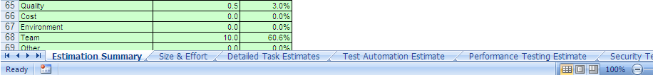
Overview
Tab | Purpose
Estimation Summary | Provides Summarized details of the estimation
Size & Effort | The will be the starting point of the estimation providing the size of the testing work
Detailed Task Estimates | This is an automated sheet illustrate the detail task breakdown with estimated values
Test Automation Estimate | Will be used to estimate test automation work
Performance Testing Estimate | Will be used to estimate Performance testing work
Security Testing Estimate | Will be used to estimate Security Testing work
Assumptions | Define estimation related assumptions
Detailed Risk Impact Estimates | Define estimation related Risks

Slide 18
Jump Start
Following 3 steps can be followed in order to perform estimation using the framework
Estimation framework has already created a set of predefined task breakdown list which covers all the aspects of the relevant work type
The estimation values will be auto generated based on the risk factors provided
Provide relevant risk factors belonging to respective testing type
Determine Type of Testing to be executed
Define Size

Slide 19


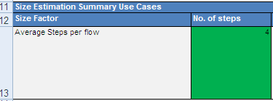



Define Testing Size
Step | Screen Navigation
Navigate to < Project Size & Effort> tab
Select the Size Estimation Method
If Method = FP , Specify the # of Function Points
If Method = Use Cases, Specify Following Average Steps per flow # of Alternative flows per Scenario # of UIs or # Screens per Scenario # of average flows per Scenario Total # of Scenarios
Based on Above input data the Total number of projected Test Case will be auto calculated

Slide 20
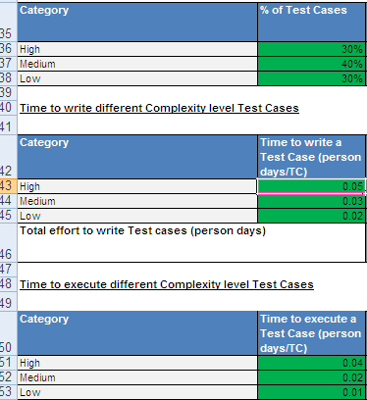


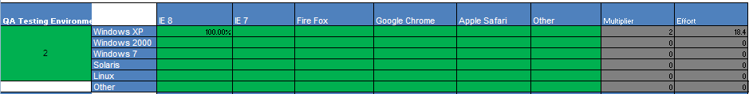
Estimating Manual Cycles
Step | Screen Navigation
Specify Test Case Complexity %, Time Average time to write and execute a test case Based on the inputs , following will be auto calculated Total Effort to write test cases (Person Days) Total effort to Execute test cases (Person Days) for an individual Cycle
Define the following test execution Details | # of Execution Cycles # of OS to be Testing & Percentage # of Browsers To Be Tested and Percentage
Test Execution percentage on an OS
Execution Effort Auto Calculated
# of Execution Cycles
Test Execution percentage on browser

Slide 21

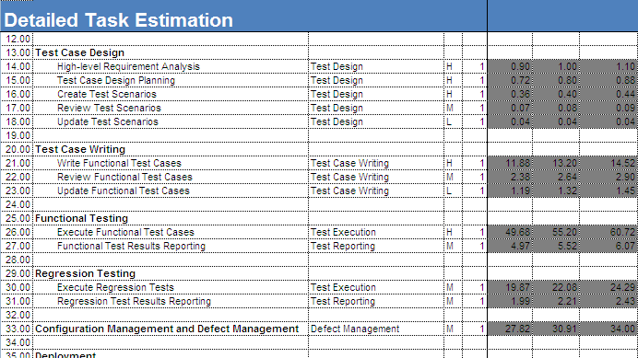
Define Size - Contd.
Step | Screen Navigation
Based on the inputs the final Test Execution Effort will be auto selected
Once the Size & Effort is filled estimation for manual test execution will be auto calculated
Auto calculated Estimation Values

Slide 22
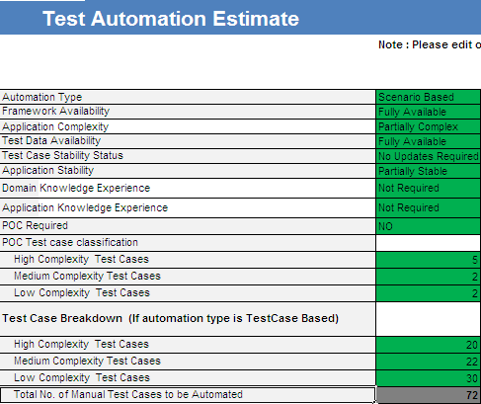
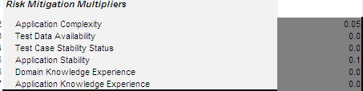
Testing Types : Test Automation Estimates
Step | Screen Navigation
Navigate to < Test Automation Estimate> tab
Specify the RISK Factors Framework Availability Application Complexity Test Data Availability Test Case Stability Status Application Stability Domain Knowledge Experience Application Knowledge Experience POC Requirement POC Test Case Classification Test Case Break Down Scenario Break Down Tool Used Number of Execution Cycles
Based on the values given the Risk factors will be auto calculated

Slide 23
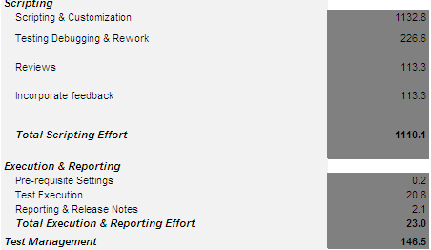
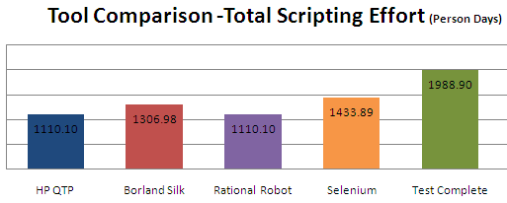
Testing Types : Test Automation Estimates - Contd.
Step | Screen Navigation
Based on the inputs provided the Automation Estimate will be auto generated with a predefined task breakdown
The relevant area in the main task breakdown sheet <Detailed Task Estimates>will be auto populated
A tool wise testing effort compression will be auto generated in order for you aid the decision making process

Slide 24
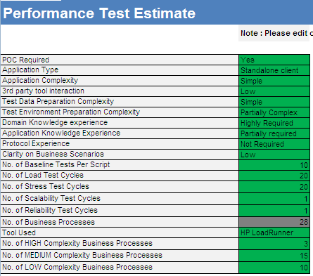
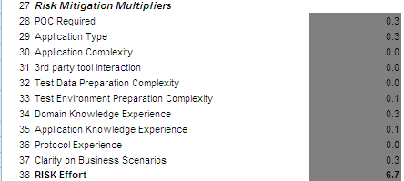
Testing Types : Performance Testing Estimates
Step | Screen Navigation
Navigate to < Performance Testing Estimate> tab
Specify the RISK Factors POC Required Application Type Application complexity 3rd Party Tool Interaction Test Data preparation and complexity Test Environment preparation and complexity Domain Knowledge Experience Application Knowledge Experience Protocol Experience Clarity of business scenarios Testing type required Business process classification
Based on the values given the Risk factors will be auto calculated

Slide 25
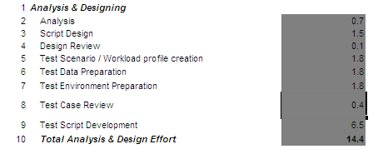
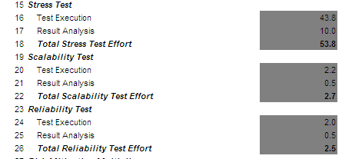
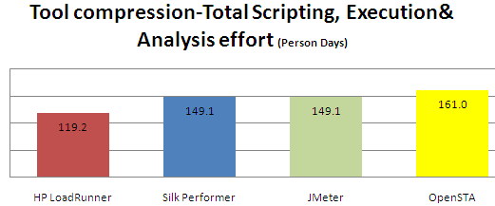
Testing Types : Performance Testing Estimates -Contd.
Step | Screen Navigation
Based on the inputs provided the Performance Testing Estimate will be auto generated with a predefined task breakdown
The relevant area in the main task breakdown sheet <Detailed Task Estimates>will be auto populated
A tool wise testing effort compression will be auto generated in order for you aid the decision making process

Slide 26
Outputs of Estimation Process
Work Breakdown Structure
High level / revised project schedule
Assumptions list
Risk and Issues list
If a pre sales activity
Resource Plan Options
Input to Pricing sheet
Input to Proposal

Slide 27
Identify and Quantify Risks
There are four risk categories that need to be understood and quantified for every project phase
Knowledge Risk: The risk of not understanding the complexity of the various components of the system (encapsulated in the best case, expected and worst case numbers of the top down and bottom up estimates)
Client Risk: Risks that the client situation creates (e.g. slow decision making)
Team Risk: Risks inherent in the Virtusa team (e.g. lack of knowledge of the technology, lack of Virtusa experience)
Environment Risk: Risks that are outside of the control of either Virtusa or the client (e.g. third party commitments)
For each risk category, Virtusa is either protected via an assumption in the contract that when broken results in a change order or the risk is quantified in person days and added to the estimate

Slide 28
Estimation Tips - General
Allocate time
Base estimates on historical data (actual numbers)
Refer to other QA estimates
Beware of creeping / unclear requirements
Identify all kinds of Risks
Include:
Quality
Documentation
Project management
Rework
Compare actual to estimates during execution and project close
Document assumptions

Slide 29
Sample Level 1 Estimation Template
- Contd..
Notes:
29

Slide 30


Corporate Headquarters
2000 West Park Drive
Westborough, MA 01581 USA
508.389.7300
www.virtusa.com
USA INDIA SRI LANKA UK
www.virtusa.com
"Virtusa" is a trademark of the company and a registered trademark in the EU and In India.
"Productization" is a service mark of the company and a registered service mark in the United States.
"vRule" is a service mark of the company.
For more information please contact SalesInquiries@virtusa.com
USA UK India Sri Lanka
Notes:
30

